Slide 1
ALGEBRA 3
Day 22

Slide 2
Bell Work: Write Equation through the following two points: (- 4, 3) and (2, -7)

Slide 3
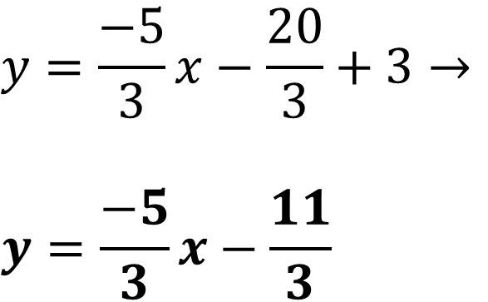
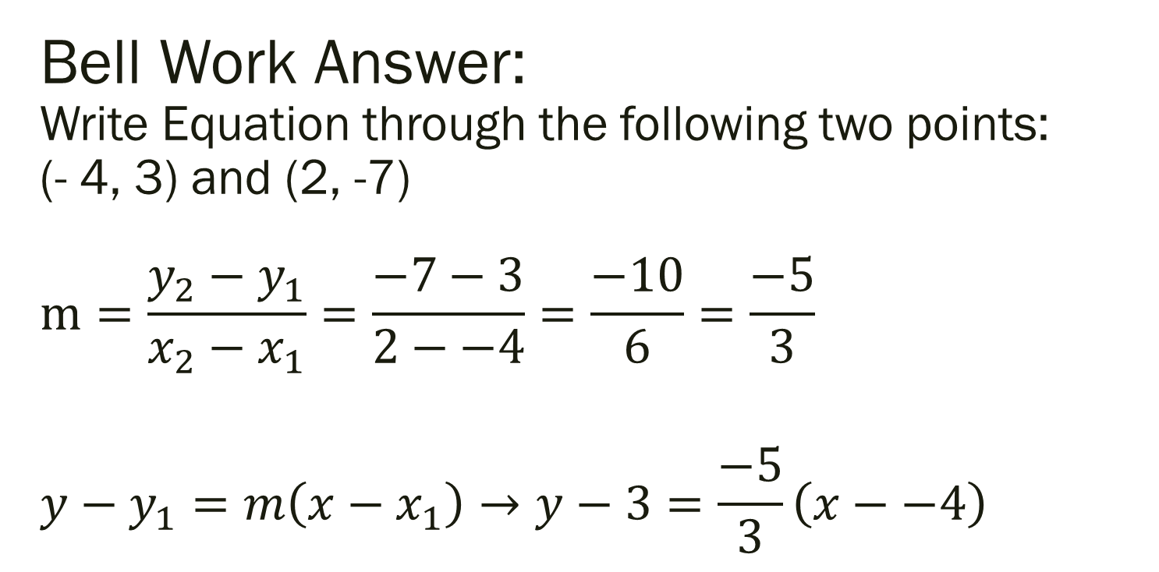
Bell Work Answer: Write Equation through the following two points: (- 4, 3) and (2, -7) $$m=\frac{y_{2}−y_{1}}{x_{2}−x_{1}}=\frac{−7−3}{2−−4}=\frac{−10}{6}=\frac{−5}{3}$$ $${y−y}_{1}=m\left(x−x_{1}\right)→y−3=\frac{−5}{3}\left(x−−4\right)$$ $$y \\ {y−y}_{1} \\ y−3=\frac{−5}{3}\left(x−−4\right) \\ y−3=\frac{−5}{3}x+ \\ \frac{−5}{3} \\ y_{1}$$
$$y=\frac{−5}{3}x−\frac{20}{3}+3→$$
$$y=\frac{−5}{3}x−\frac{11}{3}$$

Slide 4
Remember: Things on Test
Domain and Range – Is it a function?
Find the slope (given y=mx+b, ax+by=c, or two points)
Given points, write equation as y=mx+b if a line
Write equation of line (given slope and point or two points)
Graph and describe transformation of quadratic
Graph and describe transformation of absolute value
Write equation and solve a story problem

Slide 5
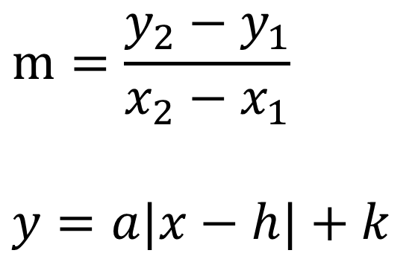

Equations Need for Test
$$m=\frac{y_{2}−y_{1}}{x_{2}−x_{1}}$$
$$y=a|x−h|+k$$
$$y=mx+b$$
$${y−y}_{1}=m\left(x−x_{1}\right)$$

Slide 6
After Test:
Finish Missing Homework from Board
Read or sit quietly and wait for everyone to be done

